Slide 1
VOCATIONAL IT · PROFESSIONAL ENGLISH
English for
Digital Interfaces
The words we use to describe what users see, choose and do.
Raúl Abad, Kelly Aruna & Steven Baldeon

Slide 2
Scrolling moves your view up or down the page
↑ scroll up
Scroll down
Move to content lower on the page.
"Scroll down to see the next section."
Scroll up
Go back to content above.
"Scroll up to return to the introduction."
Tip: the scrollbar shows where you are on the page.
↓ scroll down

Slide 3
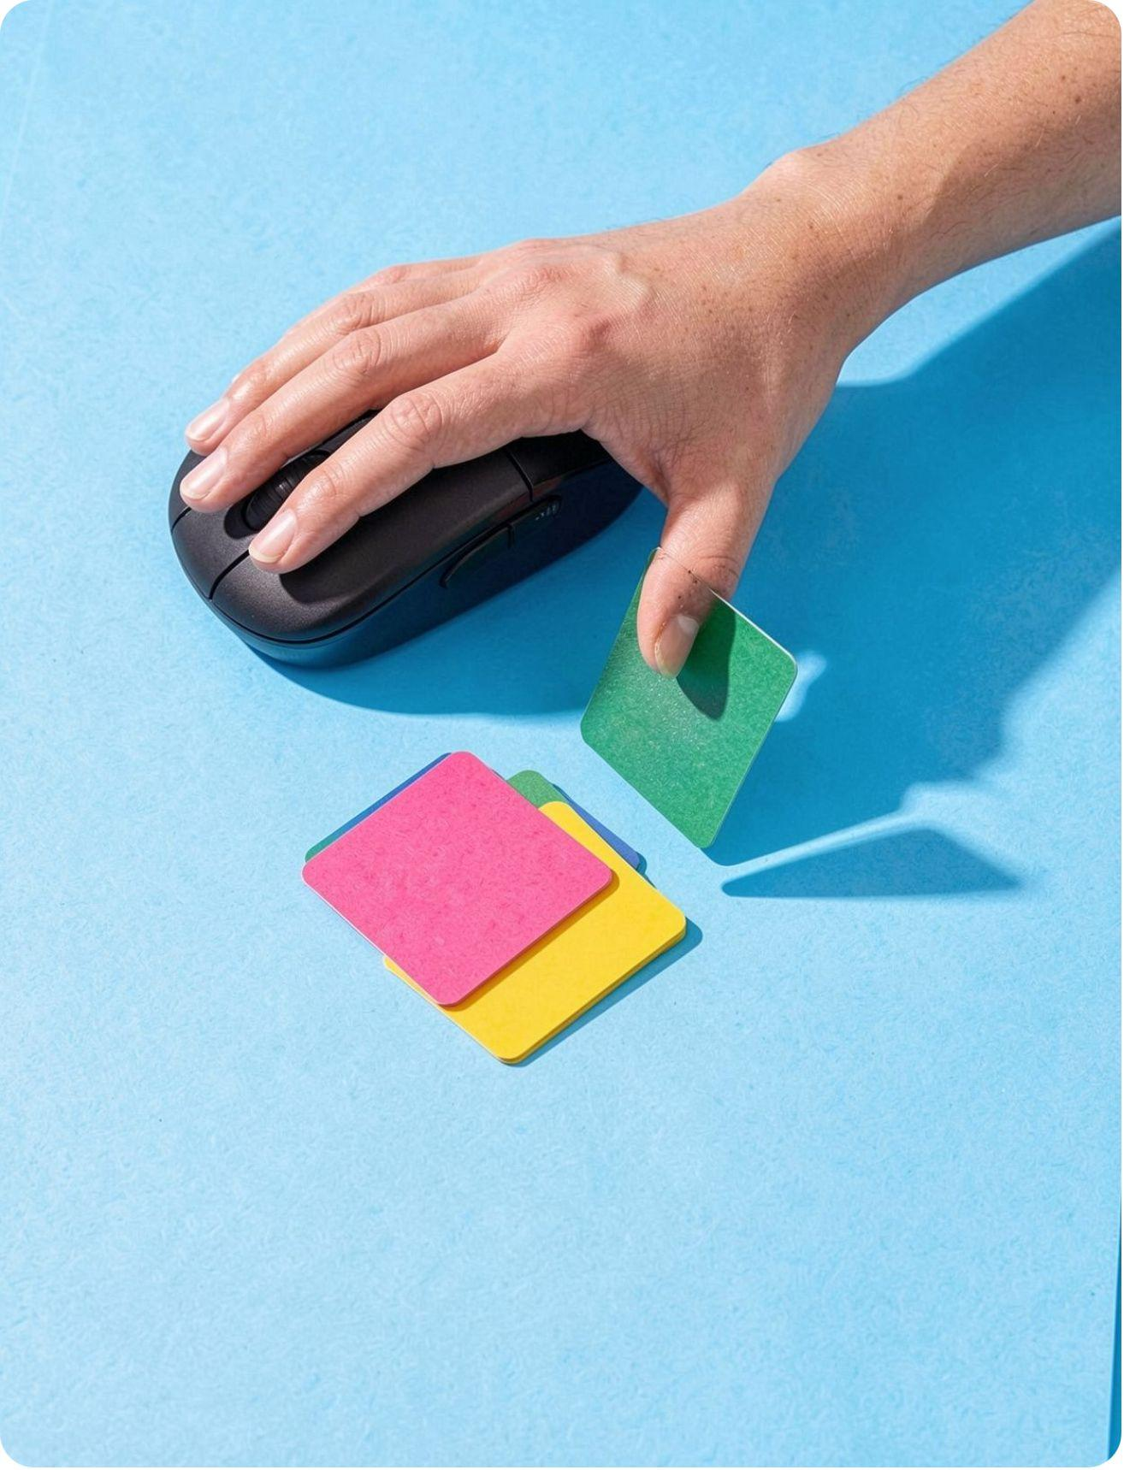
Mouse actions describe how you interact
Press and hold
Keep the left mouse button down.
Drag and drop
Move an item, then release it.
Hover over
Put the pointer on an item without clicking.
Double-click
Click twice quickly.
Right-click
Click the right button to open a context menu.
The action tells the listener what to do.

Slide 4
Touch gestures combine movement and intent
A gesture is a touch movement that triggers an action.
↔
+
−
→ swipe
Tap
Touch the screen once to select or open.
Pinch to zoom
Use two fingers: apart = zoom in, together = zoom out.
Zoom in
Make the view larger.
Zoom out
Make the view smaller.
Gesture
Any touch movement that triggers an action.

Slide 5
Focus shows where your next input will go
What it is: the field that is ready to receive typing.
How it looks: a clear outline, a highlight or a blinking cursor.
What it does: the text you type appears in that field.
Focus is not a selected answer.
Name
Ana
Email
ana@mail.com|
← focus: blue outline + cursor
Submit
Example: press Tab to move focus to "Email", then type.

Slide 6
Checkboxes allow several choices; radio buttons choose one
Checkboxes: several choices
Independent options, e.g. interests.
Radio buttons: one choice
One option in a group, e.g. delivery.
✓
Web design
Standard delivery
✓
Networking
Express delivery
Cybersecurity
Ask first: "Can the user choose more than one?" Yes → checkboxes. No → radio buttons.

Slide 7
Drop-down buttons, cards and badges
Drop-down button
Opens a list of actions or choices.
Card
Groups related content in one panel.
Badge
A small label that shows status.
image
Sort by ▾
New
Newest
In progress
Price
Laptop Pro
€899
Name
Sold out
Buy
Messages
3

Slide 8
Breadcrumbs show location; tooltips explain controls
Breadcrumb: a trail of links that shows where you are.
Tooltip: a short hint near a control, often when you hover over it.
Home › Courses ›
English
breadcrumb
Open settings
tooltip (on hover)
Two clues: where you are, and what a control does.

Slide 9
Putting it all together: a form walkthrough
1
Hover and focus
Hover over a field: a tooltip appears. Click or tap it: the field gets focus.
2
Choose and check
Choose one radio button, then check the boxes you want.
3
Open and navigate
Open the drop-down, then use the breadcrumb to go back.

Slide 10
Thank you!
Any questions?
scroll · hover · drag and drop · tap · pinch to zoom · focus · checkbox · radio button · drop-down · card · badge · breadcrumb · tooltip

